Slide 1
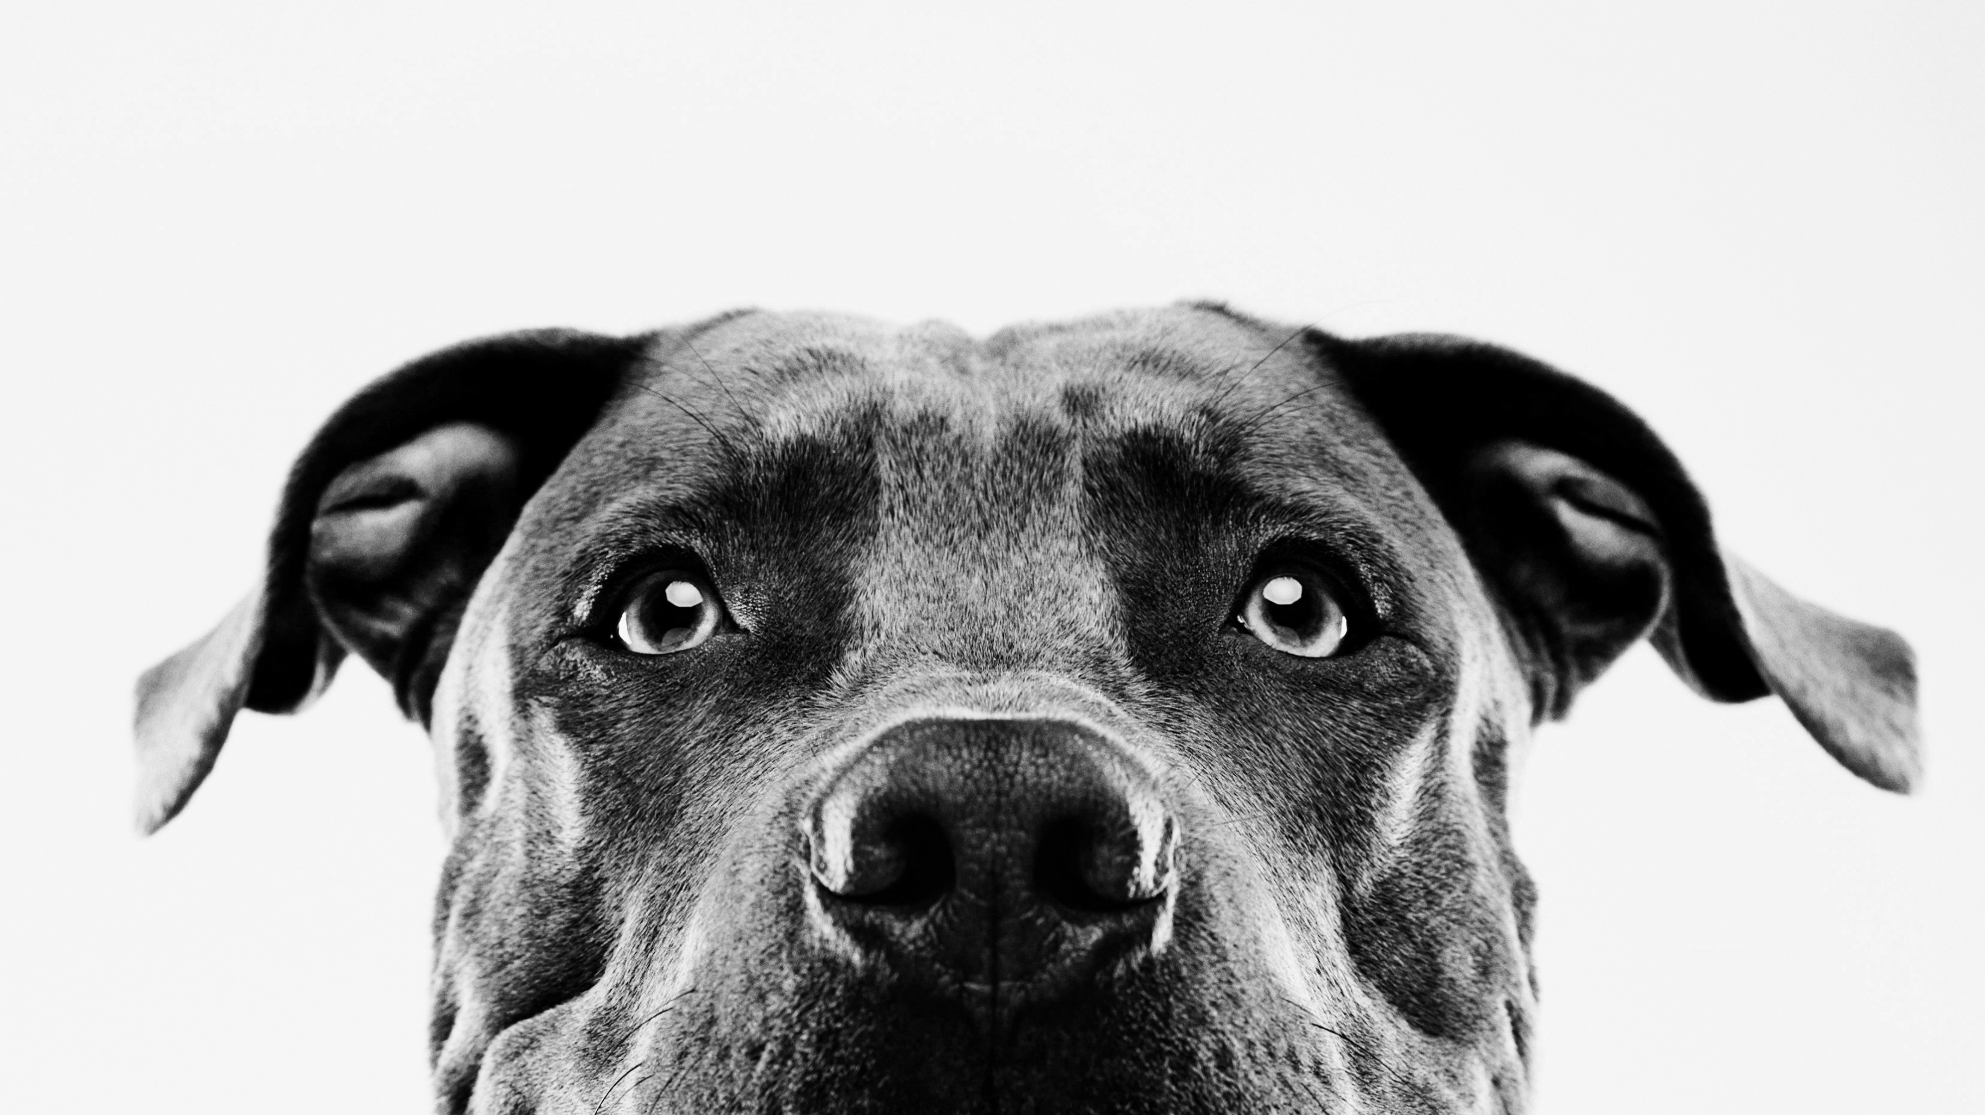
MINI PROJECT 1
Presented by Ian purificacion

Slide 2

Table of Content
Objectives
Scope
limitation

Slide 3

Objectives
To make the Buyer buys without to much hustle.
Enable to Collaborate and Work with Us.
Ignite the world's curiosity and captivate minds, propelling our platform to the forefront of global recognition

Slide 4
Scope
You can buy our NFT here no difficulty.
This project is will never going to be Rug Pull because our team is legitimate and had their socmed account linked in our website.
This Website is also safe and secure.

Slide 5
LIMITATIONS
Other buttons aren’t functional. I will fix and improve this.
Some of contents aren’t mobile friendly. I will improve this soon.

